Slide 1

Note: The data and information in this document is reflective of a hypothetical situation and client. This document is to be used for KPMG Virtual Internship purposes only.
Sprocket Central Pty Ltd
Data analytics approach
[Human Resource] - [Bob Marley], [Portus Odenge], [Denis K Thuo]

Slide 2
Note: The data and information in this document is reflective of a hypothetical situation and client. This document is to be used for KPMG Virtual Internship purposes only.
Agenda
Introduction
Data Exploration
Model Development
Interpretation

Slide 3
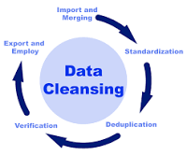
Note: The data and information in this document is reflective of a hypothetical situation and client. This document is to be used for KPMG Virtual Internship purposes only.
Introduction
DATA PREPARATION
This process aims to clean up data by removing the outliers and mitigation of filling of null values.Also joining the two different tables for further information on the project
Place any supporting images, graphs, data or extra text here.

Slide 4
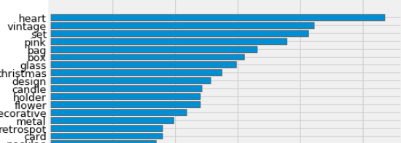
Note: The data and information in this document is reflective of a hypothetical situation and client. This document is to be used for KPMG Virtual Internship purposes only.
Data Exploration
Exploring the content of variables
Exploration will involve gaining insights from the following;
Customers
Products
Orders
Prices
Location
Place any supporting images, graphs, data or extra text here.

Slide 5
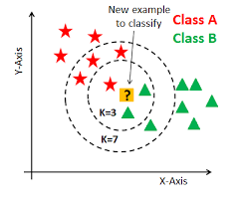
Note: The data and information in this document is reflective of a hypothetical situation and client. This document is to be used for KPMG Virtual Internship purposes only.
Model Development
Clustering algorithm
In the following, I will create clusters of customers. In practice, before creating these clusters.In this case I will use this base in order to create a representation of different clusters and thus verify the quality of separation of different groups.KNN algorithm is the recommended one.
Place any supporting images, graphs, data or extra text here.

Slide 6
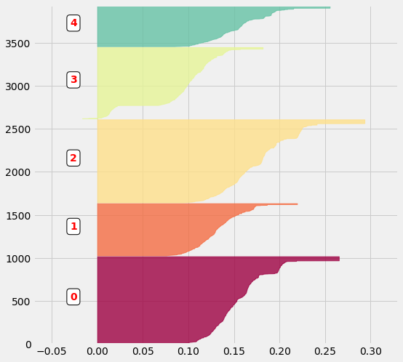
Note: The data and information in this document is reflective of a hypothetical situation and client. This document is to be used for KPMG Virtual Internship purposes only.
Interpretation
Visualization on the findings
Our interpretation is to based on images extracted from the data including but limited to;
Pie chart
Bar graphs
Principal component analysis
Silhouette intra-cluster score
Place any supporting images, graphs, data or extra text here.

Slide 7
Note: The data and information in this document is reflective of a hypothetical situation and client. This document is to be used for KPMG Virtual Internship purposes only.
Appendix

Slide 8
Note: The data and information in this document is reflective of a hypothetical situation and client. This document is to be used for KPMG Virtual Internship purposes only.
Appendix
This is an optional slide where you may place any supporting items.

